Slide 1
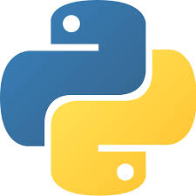
Modules - Python

Slide 2
Modules - Python
In python module can be defined as a python program file which contains a python code including python functions, class, or variables.
In other words, we can say that our python code file saved with the extension (.py) is treated as the module.
Example: calc.py
def sum(a,b):
return a+b
def sub(a,b):
return a-b

Slide 3
Modules - Python
To use the functionality of one module into another, we have to import the specific module.
Loading/importing the module in our python code:
We need to load/import the module in our python code to use it’s functionality.
Python provides two types of statements as defined below.
import statement
from-import statement

Slide 4
Modules - Python
import statement:
The import statement is used to import all the functionality of one module into another.
Here, we must notice that we can use the functionality of any python source file by importing that file as the module into another python source file.
We can import multiple modules with a single import statement.
Syntax:
import module1,module2..

Slide 5
Modules - Python
from-import statement
Instead of importing the whole module into the another module, python provides the flexibility to import only the specific attributes of a module. This can be done by using from - import statement.
Syntax:
from module-name import function1,function2…

Slide 6
Modules - Python
Renaming a module:
Python provides us the flexibility to import some module with a specific name so that we can use this name to use that module in our python source file.
Syntax:
import module-name as specific-name

Slide 7
Modules - Python
Scope of variables:
In Python, variables are associated with two types of scopes.
Global Scope:
All the variables defined in a module and outside the function contain the global scope.
Local Scope:
All the variables defined inside a function contain a local scope that is limited to this function itself. We cannot access a local variable globally.
If two variables are defined with the same name with the two different scopes, i.e., local and global, then the priority will always be given to the local variable.

Slide 8
Modules - Python
Namespaces in Python:
A namespace is basically a system to make sure that all the names in a program are unique and can be used without any conflict.
A namespace is a system to have a unique name for each and every object in Python. An object might be a variable or a method.
Python itself maintains a namespace in the form of a Python dictionary.

Slide 9
Modules - Python
Types of namespaces:
Local Namespace: This namespace includes local names inside a function. This namespace is created when a function is called, and it only lasts until the function returns.
Global Namespace: This namespace includes names from various imported modules that you are using in a project. It is created when the module is included in the project, and it lasts until the script ends.
Built-in Namespace: This namespace includes built-in functions and built-in exception names. Like print (), input (), list () and etc.

Slide 10
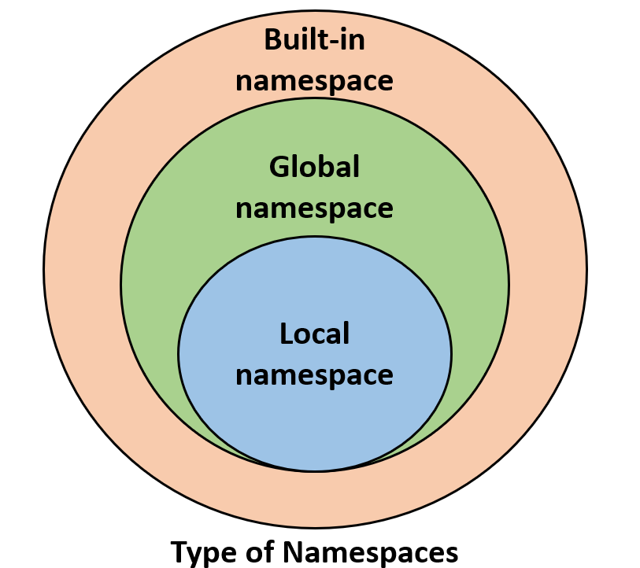
Modules - Python

Slide 11
Modules - Python
Module Built-in Functions:
The Python interpreter has a number of built-in functions. They are loaded automatically as the interpreter starts and are always available.
For example, print() and input() for I/O. int(),float(),complex(), for number conversion functions. list(), tuple(), set() for data type conversions and etc,
A module is a file containing definitions of functions, classes, variables, constants or any other Python objects. Some functions are pre-defined in module; those are called as built-in functions in module.

Slide 12
Modules - Python
Python supports following Module built-in functions, those are
dir():
The dir() function returns a sorted list of names defined in the passed module. This list contains all the sub-modules, variables and functions defined in this module.

Slide 13
Modules - Python
globals() and locals() :
The globals() and locals() functions can be used to return the names in the global and local namespaces depending on the location from where they are called.
If locals() is called from within a function, it will return all the names that can be accessed locally from that function.
If globals() is called from within a function, it will return all the names that can be accessed globally from that function.
The return type of both these functions is dictionary. Therefore, names can be extracted using the keys() function.

Slide 14
Modules - Python
reload():
For reasons of efficiency, a module is only loaded once per interpreter session. But a module can contain executable statements as well, usually for initialization. Python allows us to reload a previously imported module.
In python the reload () method reloads a previously imported module.
Syntax:
import importlib
importlib.reload(module)

Slide 15
Packages - Python
Python Packages:
In python a Package contains collection of modules and sub-packages.
Packages are a way of structuring many packages and modules which help in a well-organized hierarchy of data set, making the packages and modules easy to access.
Just like there are different drives and folders in an OS to help us store files, similarly packages help us in storing other sub-packages and modules, so that it can be used by the user when necessary.

Slide 16
Packages - Python
Example:
Here, there is a directory named “mypkg” that contains three modules,Mod1.py,Mod2.py and Mod3.py.
To create a package in Python, we need to follow these three simple steps:
First, we create a directory and give it a package name, preferably related to its operation.
Then we put the all modules in it.
Finally we create an __init__.py file inside the directory(folder), to let Python know that the directory is a package.(This is optional from python 3.3)
mypkg
Mod1
Mod2
Mod3

